Slide 1
How to build community when there are no easy answers May 13, 2015 FoCoFuture Forums
Martín Carcasson, Ph.D.
Director of the Center for Public Deliberation
Associate Professor, Department of Communication Studies

Slide 2
CPD Projects, 2006-2015
Civic mission of schools
Grade configuration of Poudre School District schools
Statewide dropout rate
Colorado Health Care Reform
Student housing
Improving higher education
Childhood obesity
Bicycle safety
Diversity Dialogues at CSU Diversity Conference
STEM education in K-12
Arts Engagement Summit
UniverCity Connections (CSU/Old Town collaborative project)
School budgeting issues/school closures
Medical Marijuana
Regional visioning process
Water and growth issues
Poverty in Larimer County
PSD Student Think Tank facilitator group
K-12 school improvement
Improving higher education through student-faculty reciprocity
Politics of food
Issues surrounding aging
Early childhood education
On campus stadium proposal
Senior transportation
Campus smoking
K-12 School safety
Bullying
Mental health
Culture of aging
Nature in the City
K-12 Technology
Campus climate
Senior outreach
FC water, recycling, and downtown plans

Slide 3
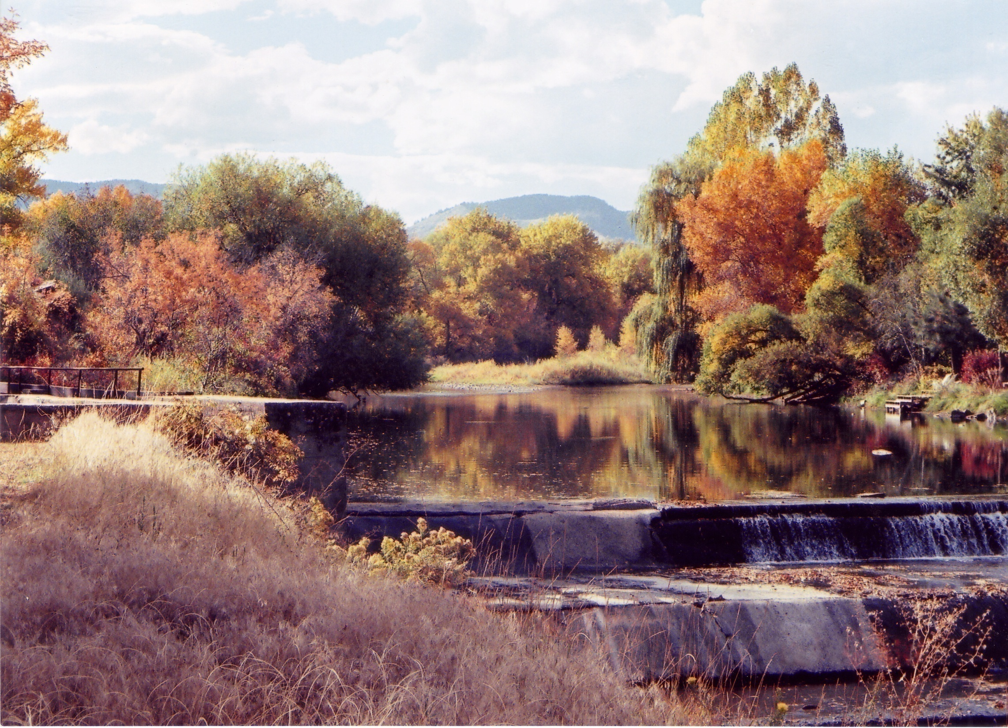
Water in Northern Colorado as a Wicked Problem
Some things we care about:
Healthy river with healthy ecosystems
Recreational opportunities
Economic vitality
Water for homes & lawns
Open space and wildlife habitat
Low cost of living
Water for local farms
Local food economy
Freedom of choice of where to live
Image courtesy of Rose Brinks.

Slide 4
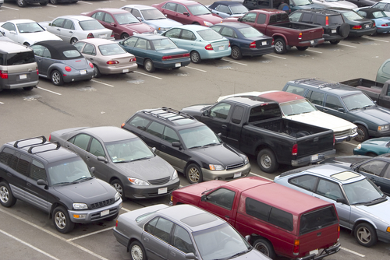
Parking at CSU as a Wicked Problem
Some things we care about:
Low cost
Fairness
Safety
Work productivity
Flexibility
Aesthetics/
Campus beauty
Convenience/
Low time cost
Low community impact/
Good neighbors
Employee morale
Environment
Consistency/Ease of use
Works for staff
Works for faculty
Works for visitors
Works for students
Works for working parents
Works for commuters

Slide 5
Basic American Values as a Wicked Problem
Freedom
Equality
Security
Community
Justice
Self-reliance
Tolerance
Cooperation
Democracy
Stability
Values set from www.choices.edu “Choices for the 21st Century Education program

Slide 6
FOOD AS A WICKED PROBLEM
WE WANT OUR FOOD TO BE:
Inexpensive
Fresh
Nutritious
Safe
Long lasting
Delicious
Convenient
(Accessible, Easy to prepare)
Ethically grown
(labor/animal welfare)
Our choice
Supportive of a local economy
Supportive of a agriculture community
Grown and delivered in a environmentally responsible manner
Supportive of efforts to reduce hunger locally and globally

Slide 7
The Printer’s Dilemma
You can have it:
Fast
Good
Or
Cheap.
Pick 2 of the three

Slide 8
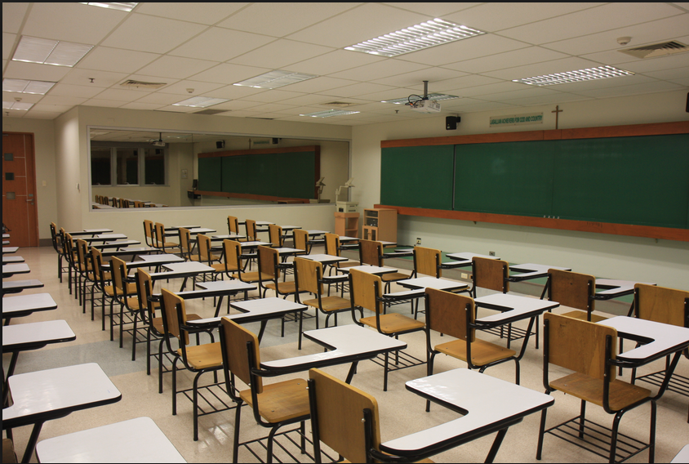
Competing values in improving student success
Quality/High expectations
Affordability/Access
Efficiency
Consistency
Flexibility
Fairness
Completion / Graduation
Innovation
Tradition, Stability

Slide 9
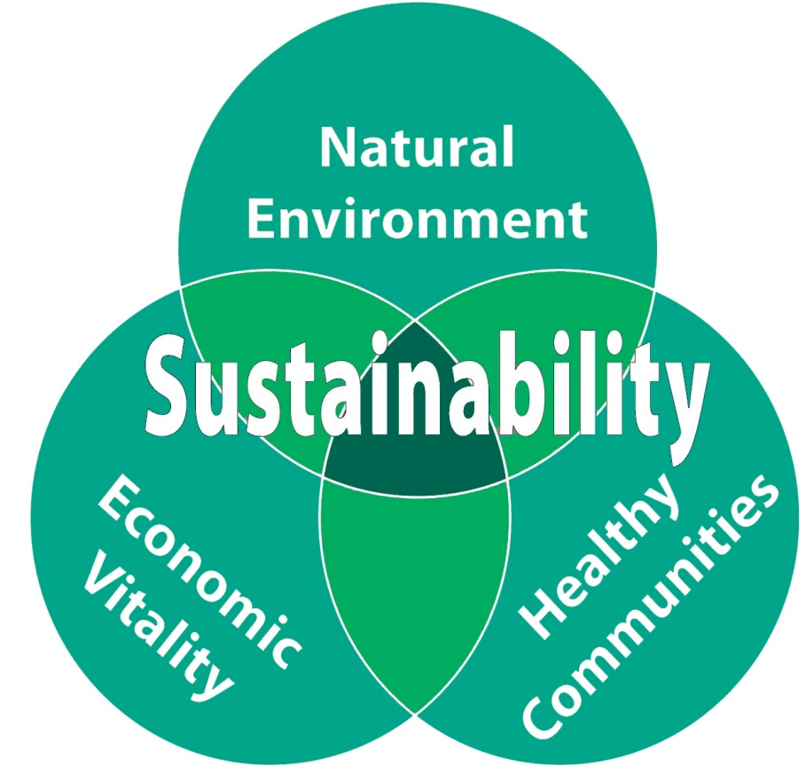
Capitalism as a wicked problem
The “Triple Bottom Line” of
Profit (economics, also tied to jobs and taxes)
People (social justice, equality, fairness)
Planet (environment)

Slide 10
Dedicated to enhancing local democracy through improved public communication and community problem solving

Slide 11
Causes of Poor Public Discourse
Human nature

Slide 12
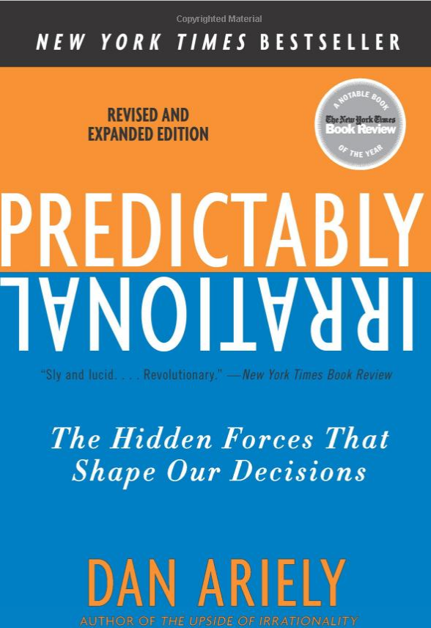
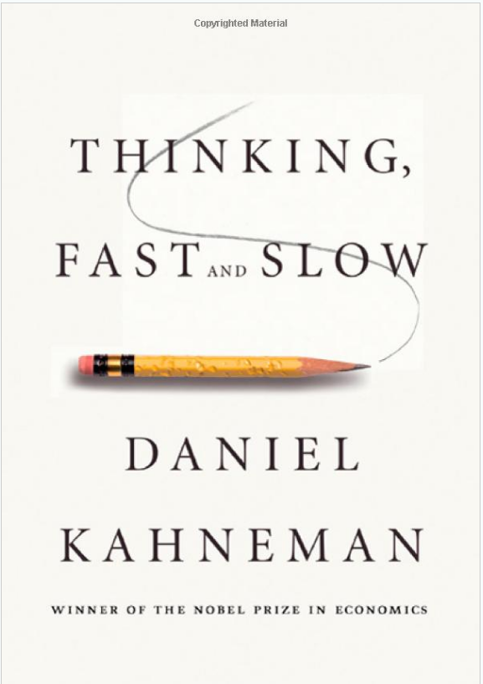
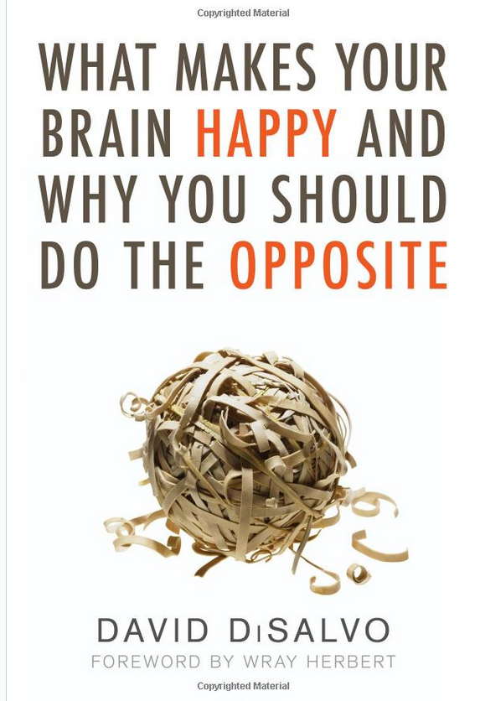

Slide 13
Causes of Poor Public Discourse
Human nature
Strategies of professional persuaders

Slide 14
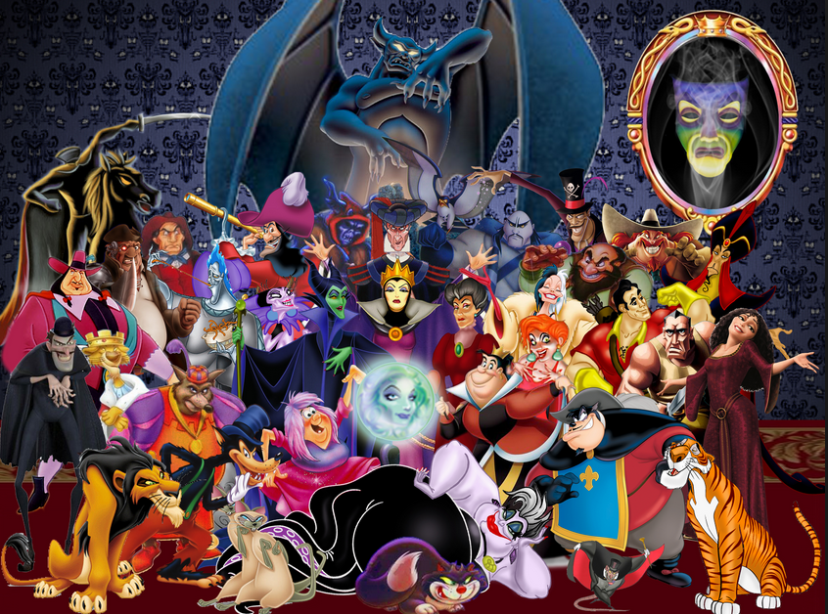

Slide 15
Causes of Poor Public Discourse
Human nature
Dominant strategies of professional persuaders
Lack of opportunity for authentic engagement

Slide 16
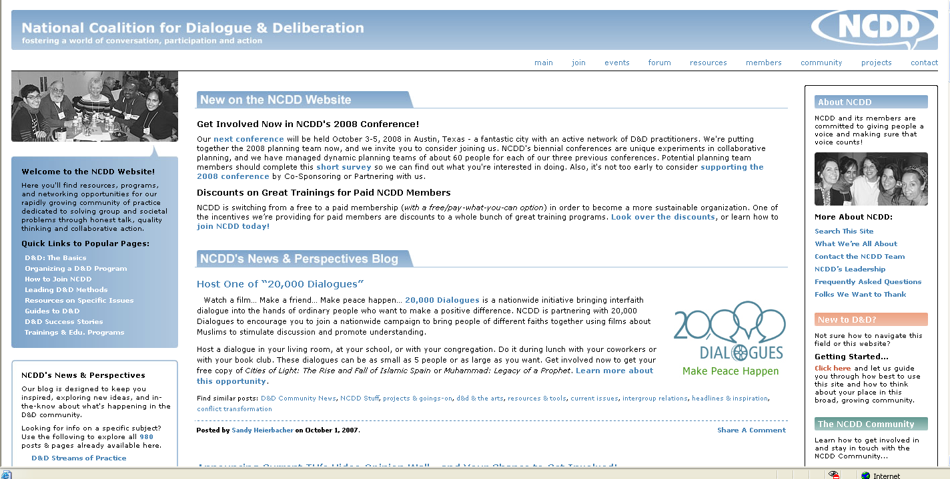
The National Coalition for Dialogue and Deliberation
www.ncdd.org

Slide 17
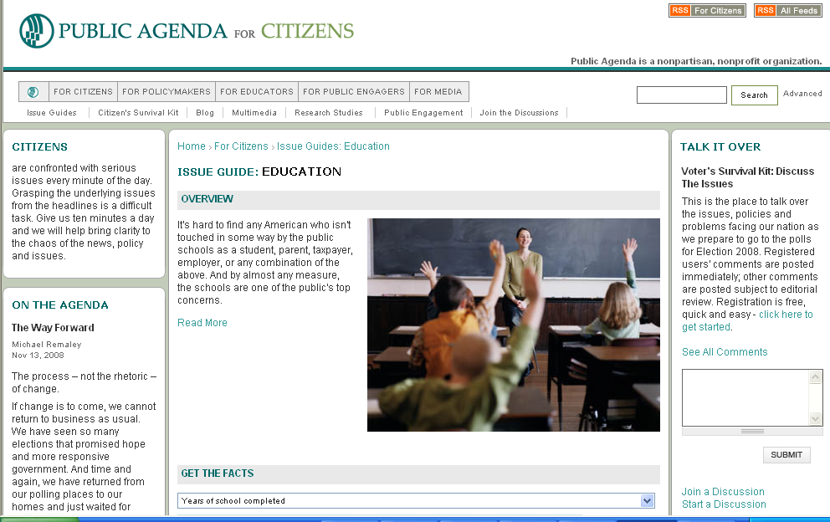
www.publicagenda.org

Slide 18
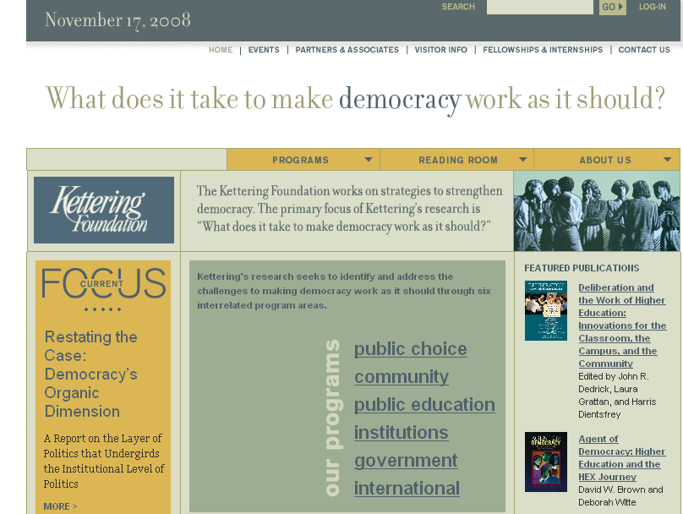

Slide 19
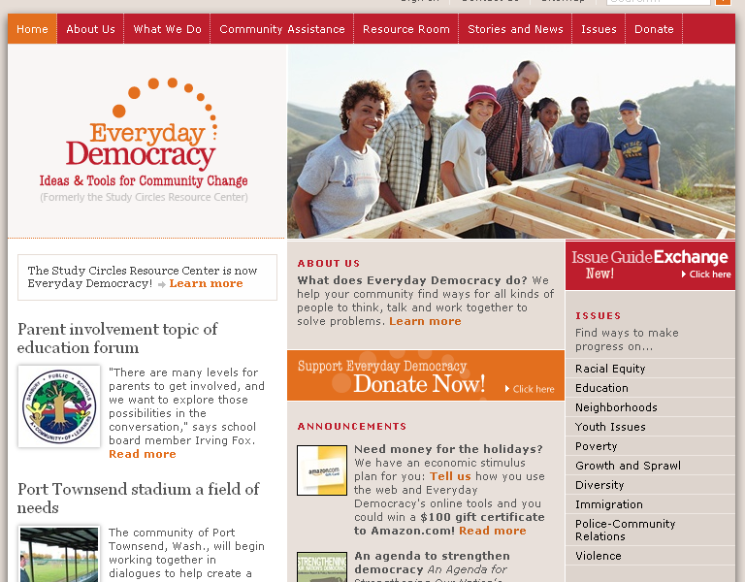

Slide 21
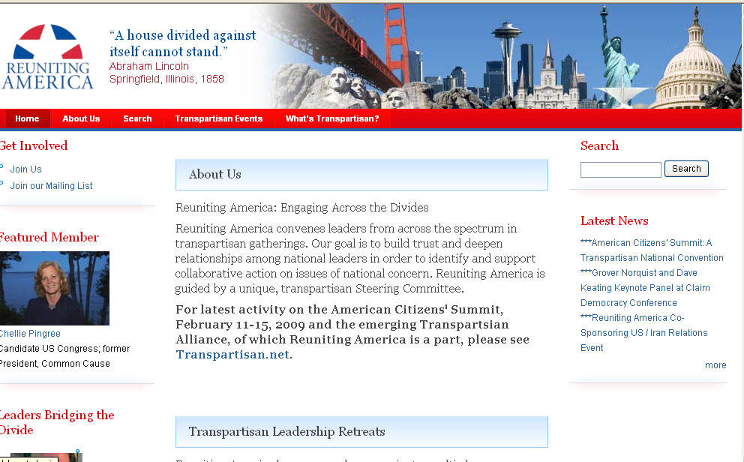

Slide 25
Sam Kaner, Facilitator’s Guide to Participatory Decision-Making

Slide 26
Sam Kaner, Facilitator’s Guide to Participatory Decision-Making

Slide 27
Not allowing enough divergent opinion
leads to
False consensus
(dissent not heard, wishful thinking supported,
decisions likely either faulty or
Unsustainable, often attracting
strong opposition)
To avoid false consensus:
Communities need better processes to insure adequate divergent thinking and that voices are heard.

Slide 28
Sam Kaner, Facilitator’s Guide to Participatory Decision-Making

Slide 29
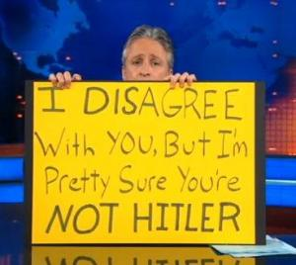

Slide 30
Exiting groan zone too early
leads to
False polarization
(sparks misunderstanding, distrust,
unsustainable one-sided solutions,
fact wars develop, spirals of conflict)
To avoid false polarization:
Communities need better processes to help them work through tough choices.

Slide 31
Sam Kaner, Facilitator’s Guide to Participatory Decision-Making

Slide 32
Getting stuck
in groan zone
leads to
Paralysis by
Analysis
(no decisions,
frustrations with process,
chilling effect for
future engagement)
To avoid paralysis by analysis:
Communities need better processes for collaboration and moving from talk to action

Slide 34
How to build community when there are no easy answers May 13, 2015 FoCoFutures Forums
Martín Carcasson, Ph.D.
Director of the Center for Public Deliberation
Associate Professor, Department of Communication Studies

