Slide 1
By the Numbers
Who Is Fort Collins
Elizabeth Garner
State Demography Office
Colorado Department of Local Affairs
2015
www.colorado.gov/demography

Slide 2
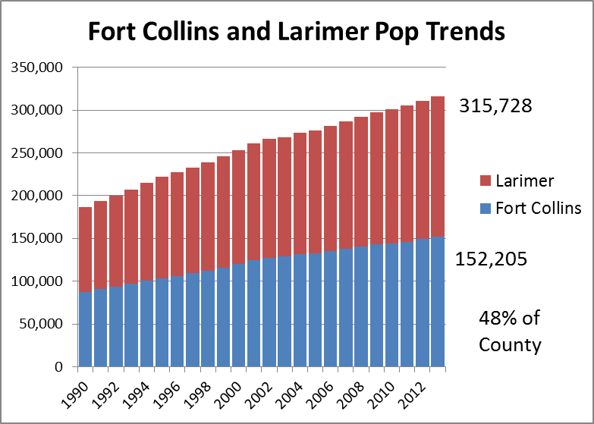
2% per year

Slide 3
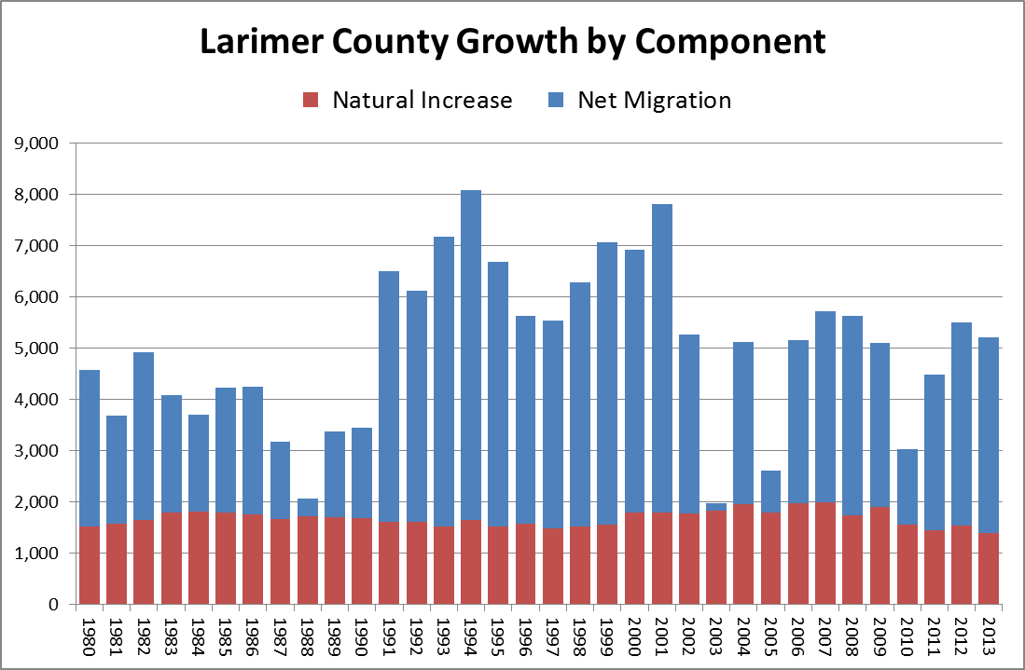
66% of Growth is Migration

Slide 4
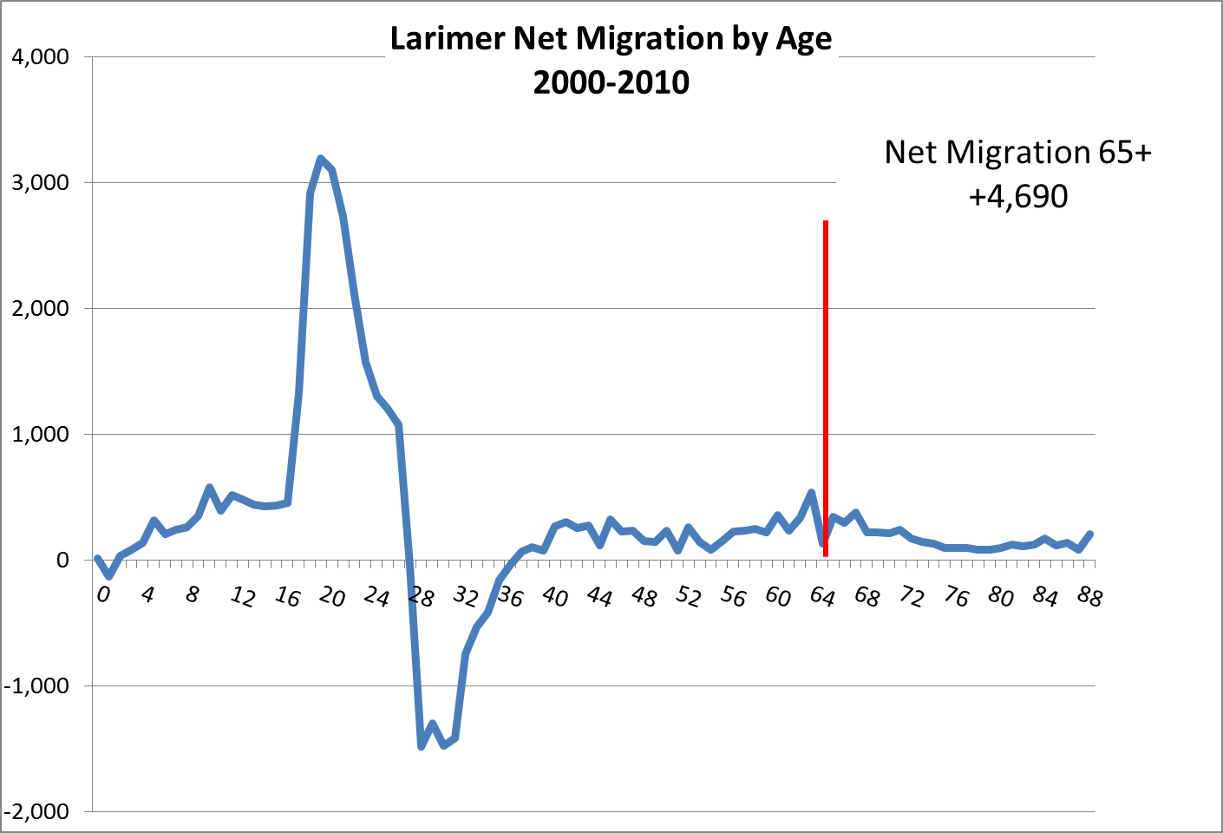
Migrants are mostly young
State Demography Office

Slide 5
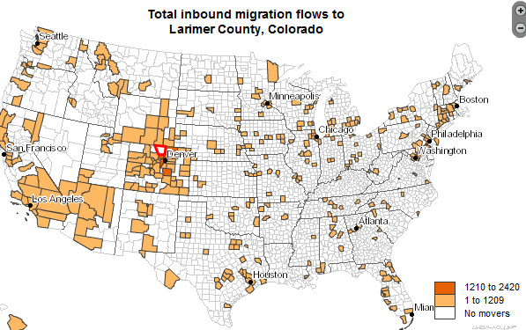
Born in State of Residence
Fort Collins 38% Colorado 42%
http://flowsmapper.geo.census.gov/flowsmapper/map.html

Slide 6
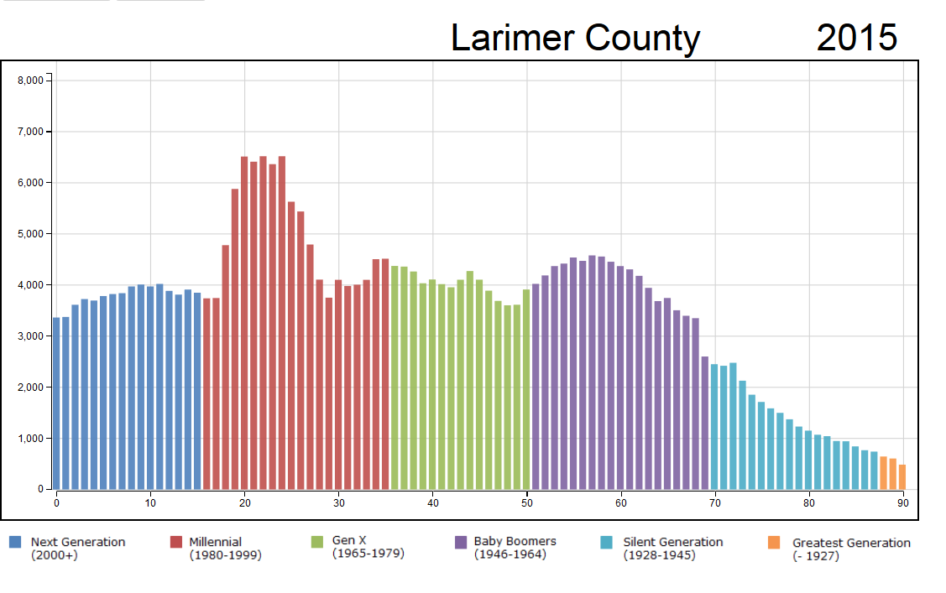

Slide 7
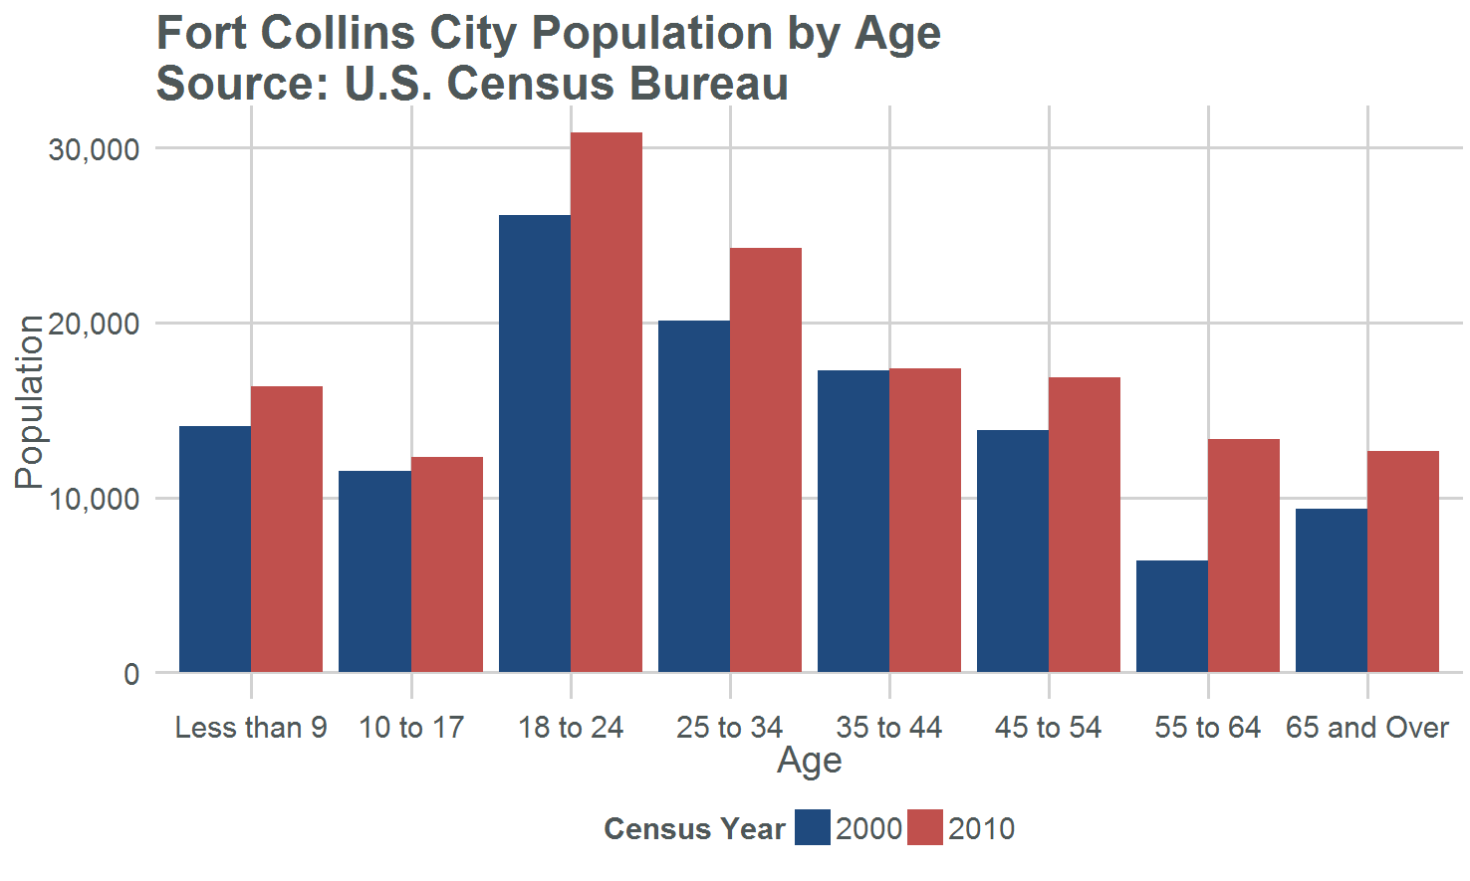
109%
21%
11%
17%
9%
9%
12%
12%
9%
Total Change = 16%

Slide 8
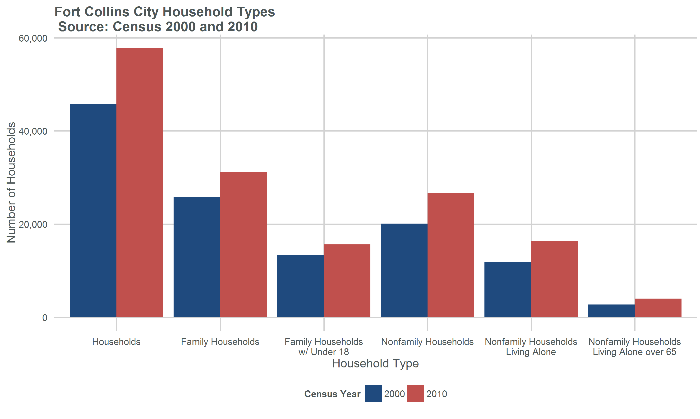
53%
46%
46%
28%
27%
7%

Slide 9
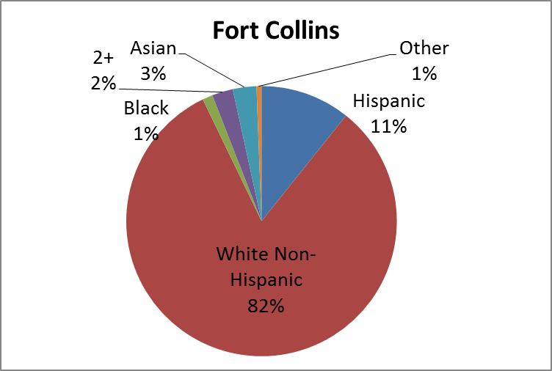

Slide 10
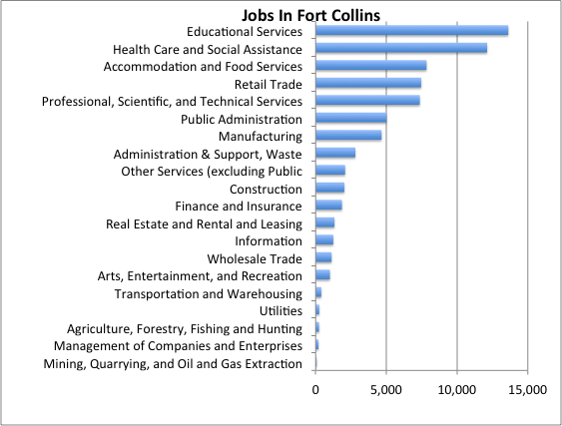
Notes:
35% in combined educational services and health care and social assistance

Slide 11
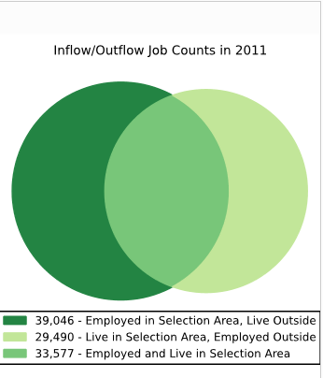
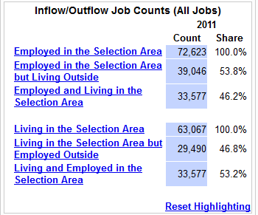
Fort Collins Commuting

Slide 12
Percent of the Population 25+ with a Bachelor’s Degree
Fort Collins 52% Colorado - 37%

Slide 13
Median Household Income
Fort Collins $53,780 Colorado $58,433

Slide 14
Median value of owner occupied housing unit
Fort Collins – $247,800
Colorado – $236,200

Slide 15
Percent of Households Paying more than 30% of their income on housing costs
Fort Collins – 27.9%
Colorado – 30.2%

Slide 16
Percent of renter households paying more than 30% of income on rent
Fort Collins – 58.2%
Colorado – 51.9%

Slide 17
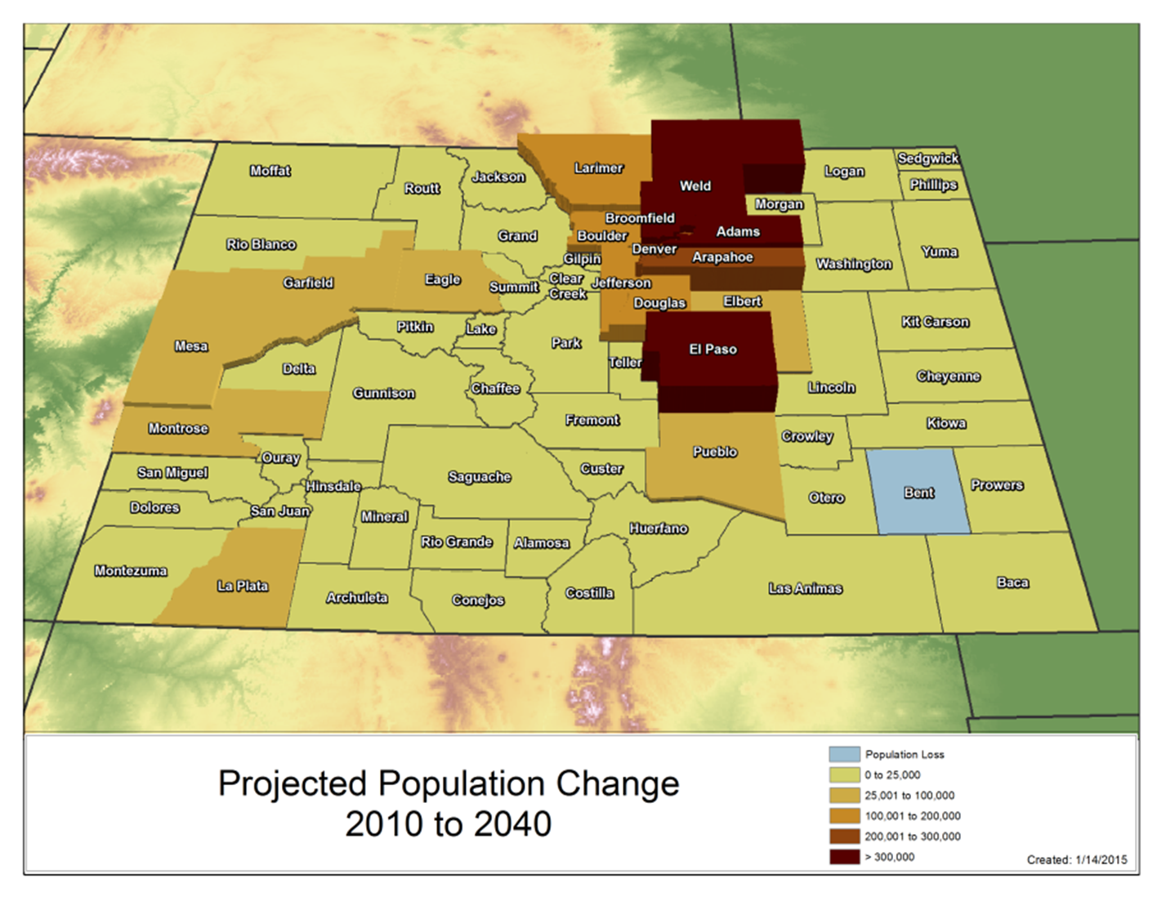
Larimer County Population Forecast for 2040
471,000

Slide 18
To Ponder in My Community
Can we manage more growth?
Can we compete for best and brightest?
Maintaining Economic and Amenity Advantages
Can we manage growth in high and low skill/wage service jobs – bifurcation ?
Are we ready for more racial and ethnic diversity?
Are we set to cope with opportunities and challenges of an aging population?
How could downward pressure on household income impact our community?
Notes:
Now lets look at

Slide 19
Thank you
State Demography Office
Department of Local Affairs
Elizabeth Garner
Elizabeth.garner@state.co.us
303-864-7750
www.colorado.gov/demography

