Slide 1
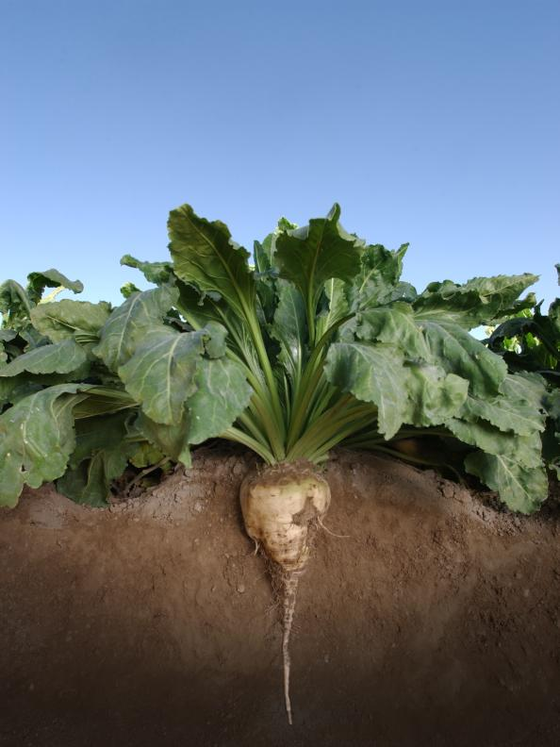
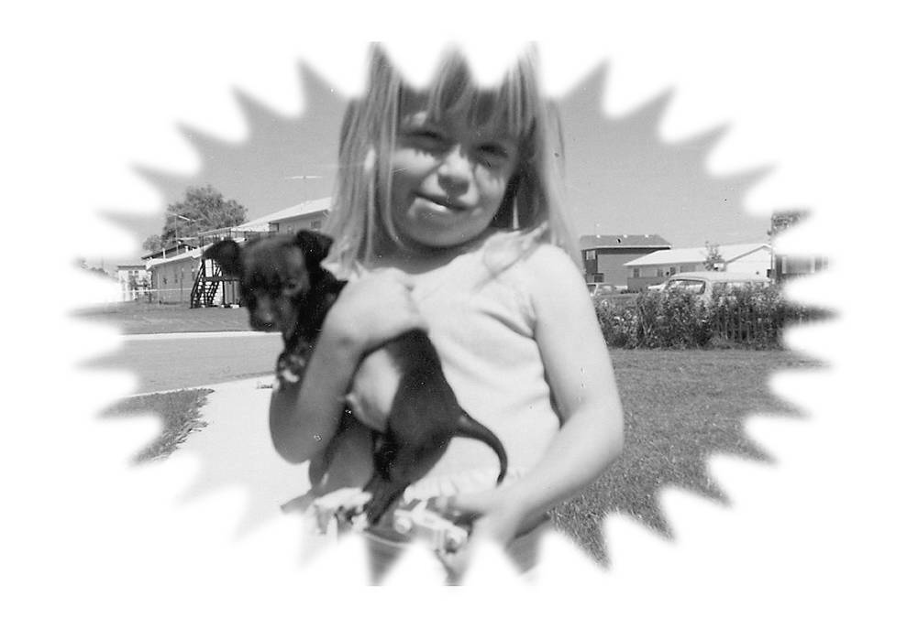
From the Roots Up: Where we came from
Presented by
Cheryl Glanz
Spark of Brilliance Productions
Photo: Hancock Seeds 2014

Slide 2
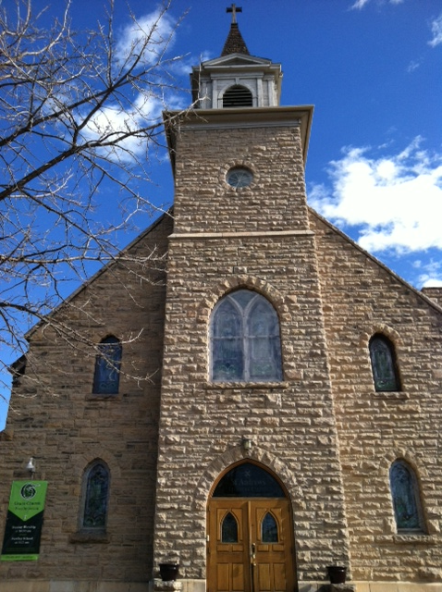
Recognizing and Honoring Unseen History and Culture in the Development of Fort Collins

Slide 3
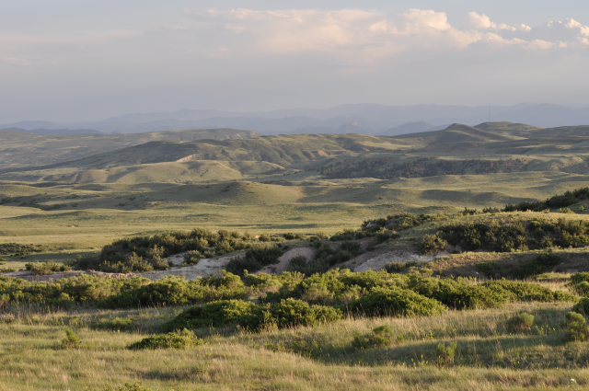
Early Culture
Soapstone Prairie Natural Area Photo: Ideal Images
Notes:
People have come to this region for a long time.
The Lindemeier site shows people have been living here for more than 10,000 years.
Great Valley - The Lindenmeier Archaeological Site is very special. It’s referred to as a sacred place by many American Indians and known by archaeologists as one of the most important Pleistocene habitation sites in the Western Hemisphere. There is an extensive and diverse human history at Soapstone Prairie - exceeding 12,000 years - from PaleoIndians of the Ice Age to millennia of American Indian groups, to more than a century of homesteaders and cattle and sheep ranchers. The most famous cultural site at Soapstone Prairie is the Lindenmeier archeological site, a National Historic Landmark. Excavations in the 1930s by the Smithsonian and Colorado Museum of Natural History conclusively dated human habitation in North America to at least 10,000 years ago and gave new insight into the Folsom culture. The sheer quantity of materials found during the years of excavation was astounding—over 51,000 artifacts. Needles, beads and stone tools were found, making the Lindenmeier site the most extensive Folsom culture campsite yet found. Learn more about the excavations >>> Other human history at Soapstone Prairie includes possible Clovis complex sites, numerous stone rings, sheep camp rock cairns, ruins of historic homesteads, ranches and their associated buildings, the foundation of a schoolhouse, and roads and trails. Learn more by watching Speaking History video Fort Collins Museum's Soapstone Prairie Oral History Project or Meeting in the Center with Respect video.

Slide 4
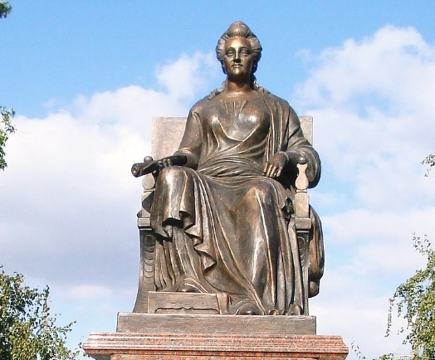
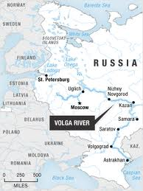
Immigration for Agriculture
Reconstructed Monument of Catherine II in Marx (Katherinenstadt), Russia – 2008
Courtesy of Dr. Kenneth Rock
Image from Alyson Hurt - NPR
Notes:
Catherine the Great recruited Germans to Russia.
Developed the bread basket region along the Volga River.

Slide 5
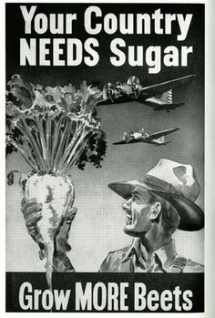
Colorado Agricultural College 1870 – Colorado State University 1957
Notes:
CO Ag College formed, developed a new sugar beet. Needed people to grow it.
Education and Innovation / Entrepreneurship .CSU was founded as Colorado Agricultural College in 1870, six years before the Colorado Territory gained statehood. It was one of 68 land-grant colleges established under the Morrill Act of 1862. Founded in 1870 and the first Freshman class of 20 students in 1879. In 1935, it became the Colorado State College of Agriculture and Mechanic Arts, or Colorado A&M, renamed Colorado State University in 1957. Today, about 30,700 total students and 26, 775 on-campus, resident-instruction students.
Late 1800’s and early 1900’s Great Western Sugar Company Recruiting for Sugar Beet labor. Sugar Beet industry was 3rd largest in the state for 50 years, still strong today.
As late as late 1970’s, student body reception in Fall included commentary about students being out for wheat harvesting and haying.

Slide 6
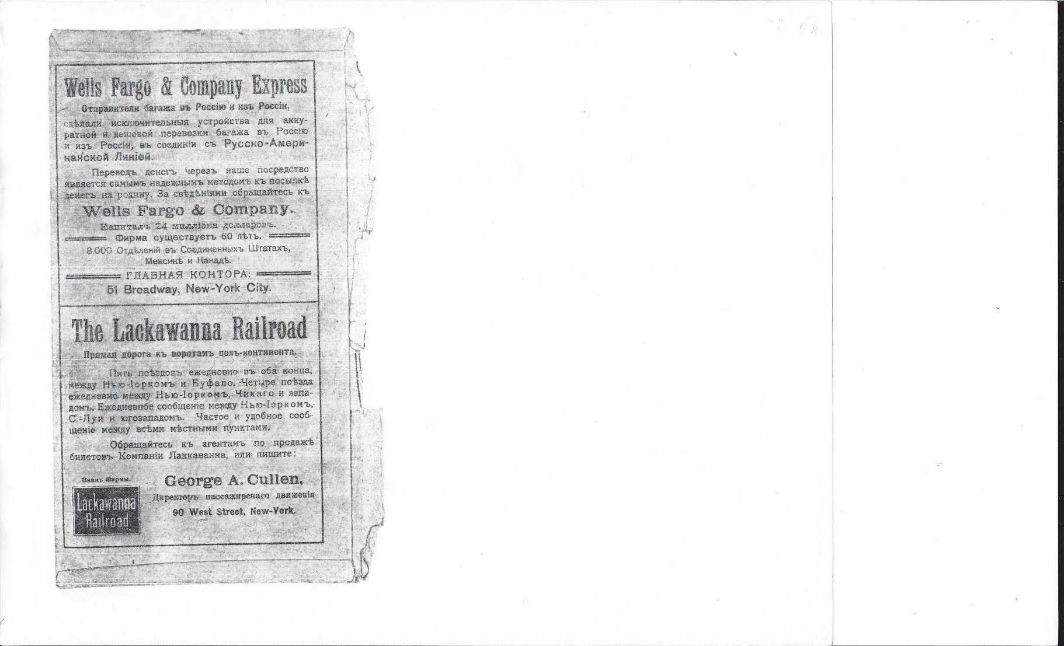
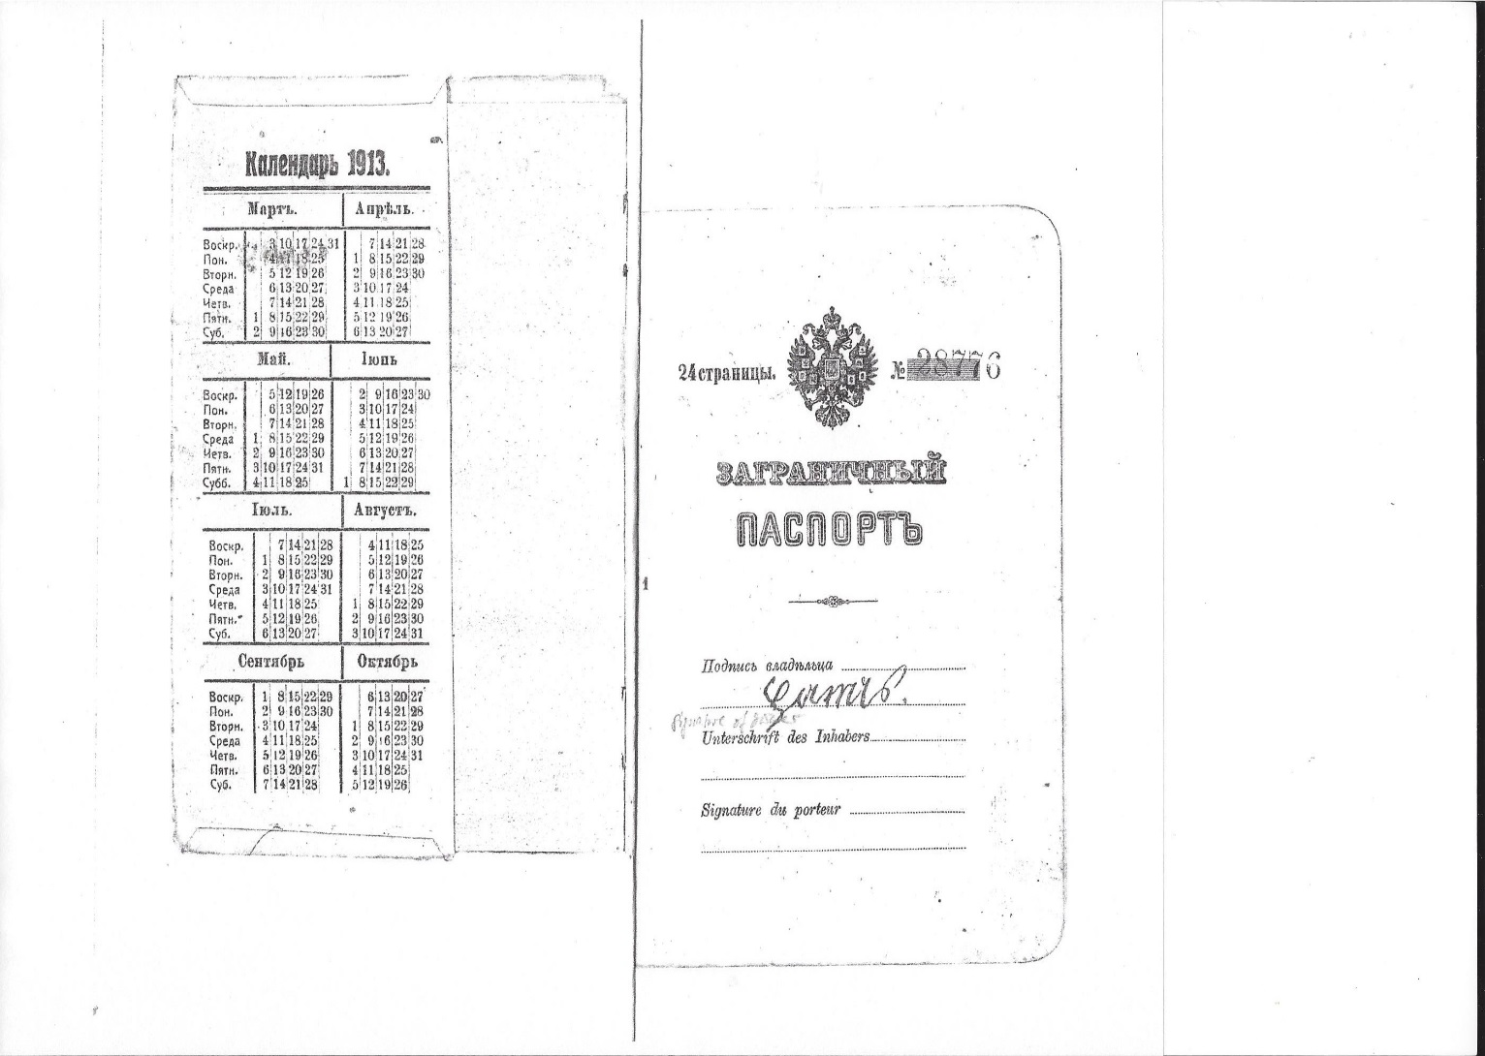
Recruitment
Notes:
Active recruitment for railroads and agriculture; Germans from Russia were experienced farmers

Slide 7
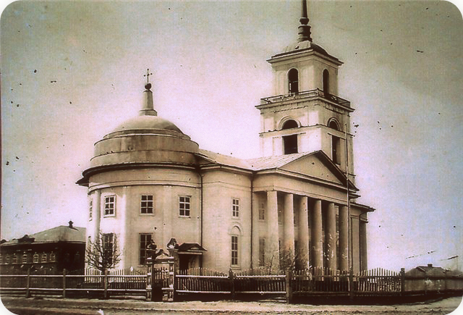
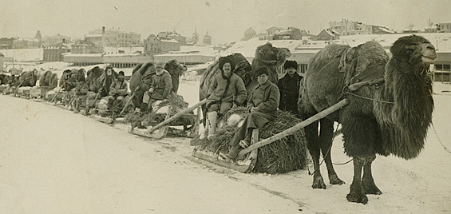
Leaving Russia
Notes:
Losing freedoms - religion, etc.
Not enough land

Slide 8
Impact
Late 1870’s marks early start of 20,000 German Russian Immigrants to Colorado
First State of Colorado Constitution was written in 3 languages – English, German and Spanish
Population of Fort Collins increased by 5,000
Notes:
http://ballotpedia.org/Colorado_Constitution
Colorado Legislation in three languages – Eng., Ger, Sp.;
Population changes – increase of 5,000 citizens between 1901 and 1910;

Slide 9
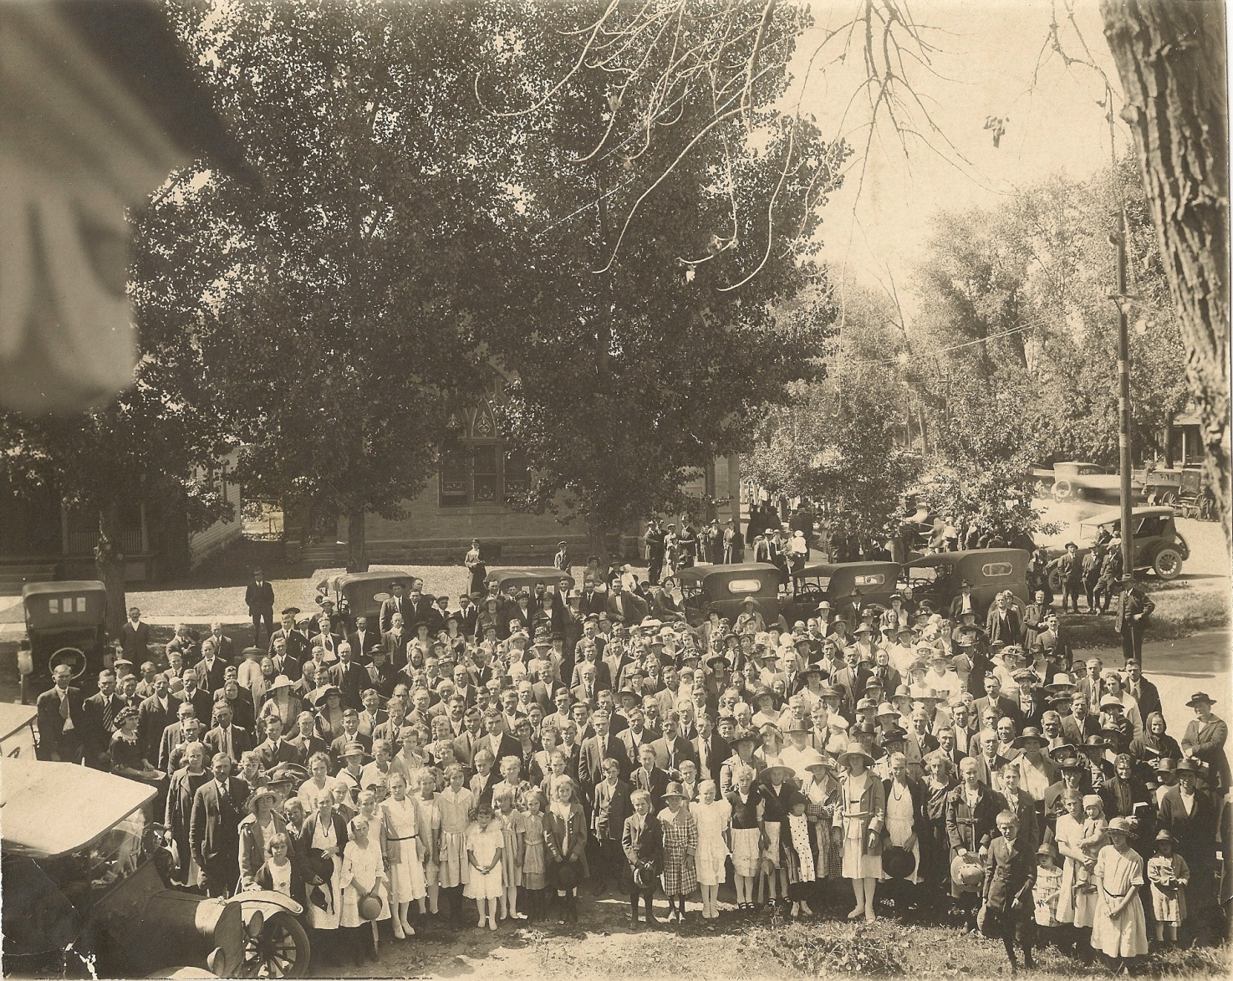
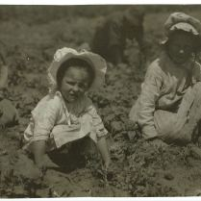
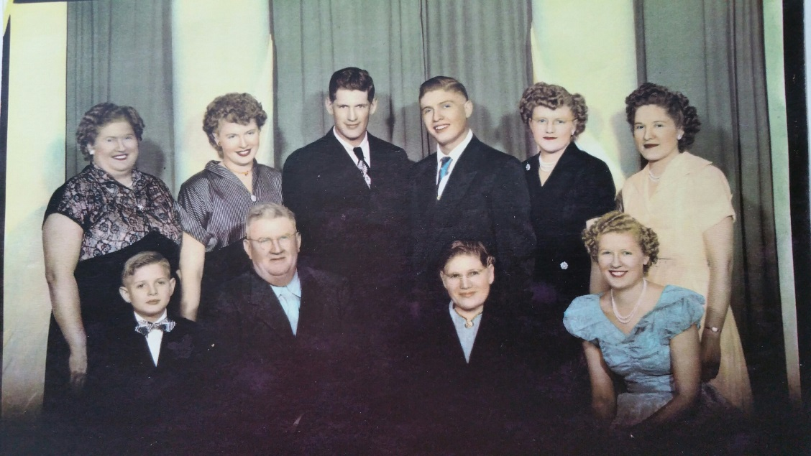
Building of Community
Notes:
Tradition of whole families emigrating as they sought to keep culture, while becoming an American was of major importance.
Prohibition;
Change of Child Labor Laws;

Slide 10
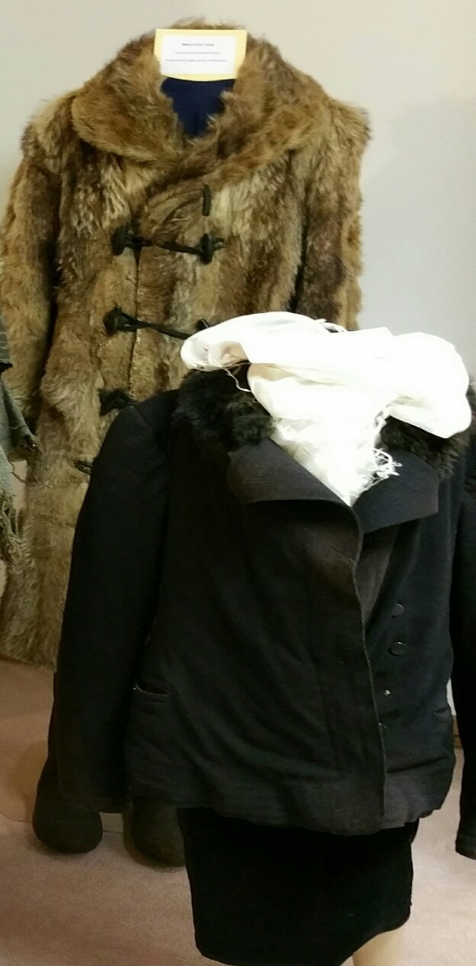
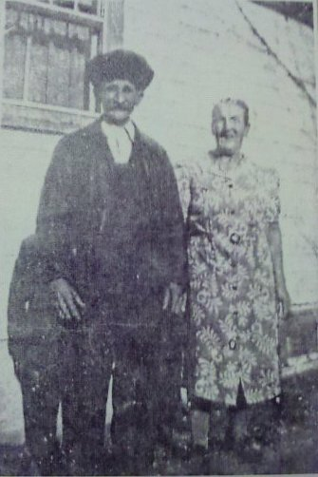
Bringing German Russian Culture to Fort Collins
Notes:
Food, clothing, traditions, music, beer

Slide 11
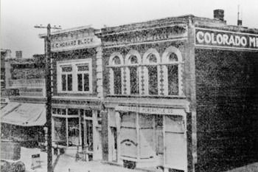
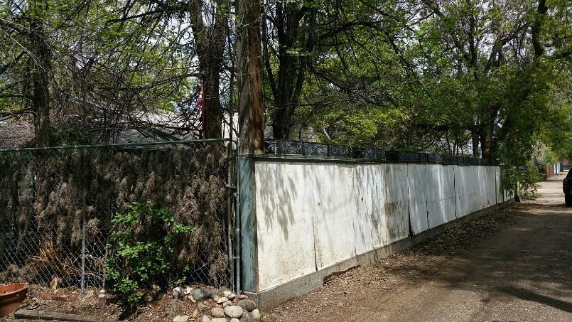
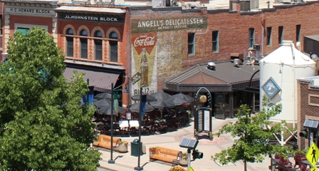
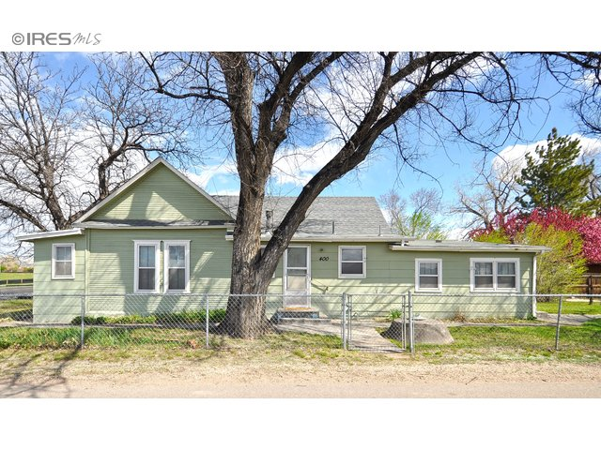
Community Foundations
“The German is like a willow. No matter which way you bend him, he will always take root again.” - Alexander Solzhenitsyn

Slide 12
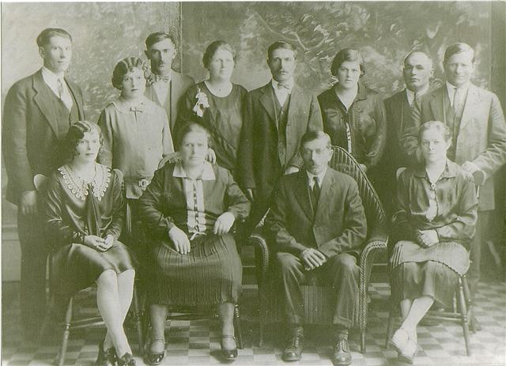
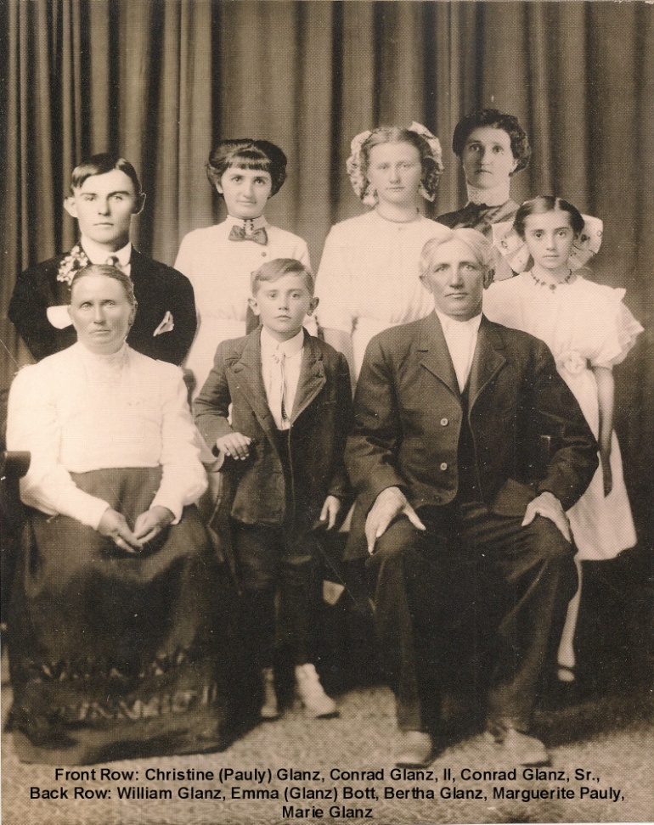
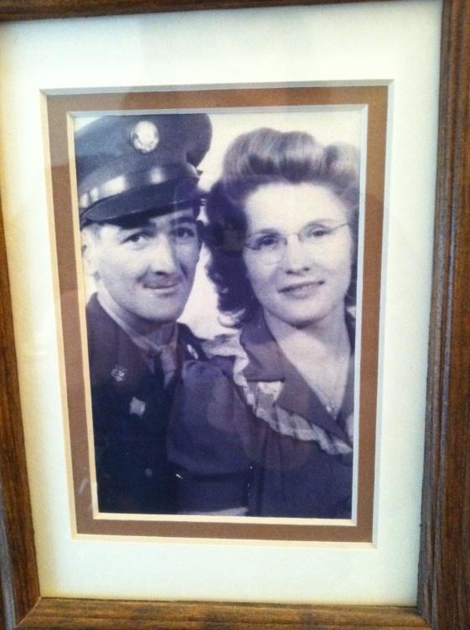
Changing Times – The Effects of War
Notes:
So why don’t you know much about the Germans from Russia in our community?
Prejudice during war, wanting to fit in.
“Russian Germans were victims of two dictators: Hitler and Stalin”
-Dr. Christoph Bergner

Slide 13
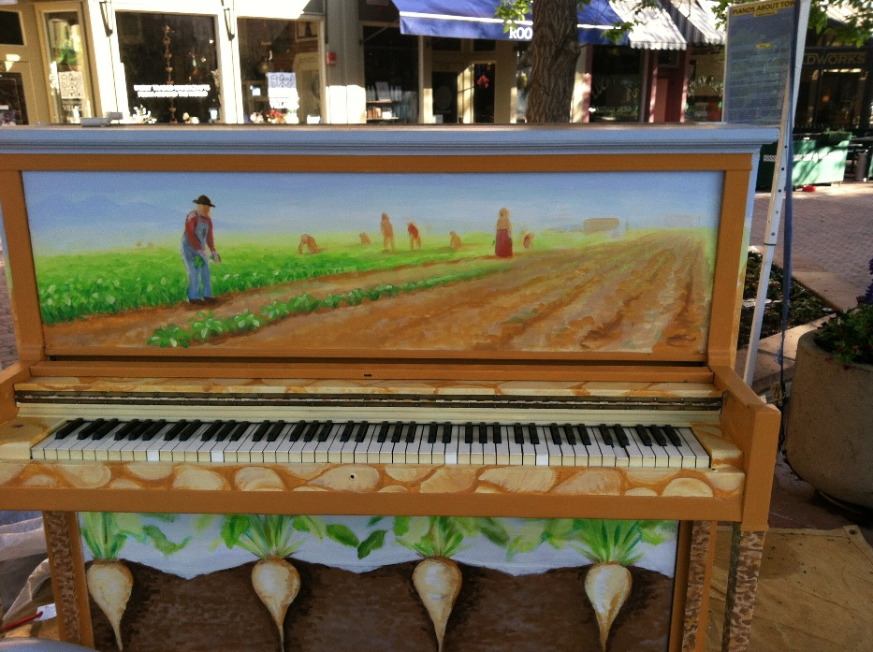
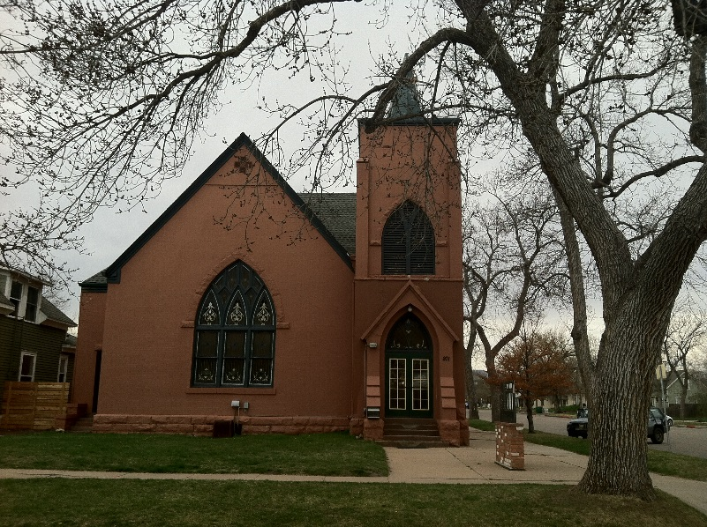
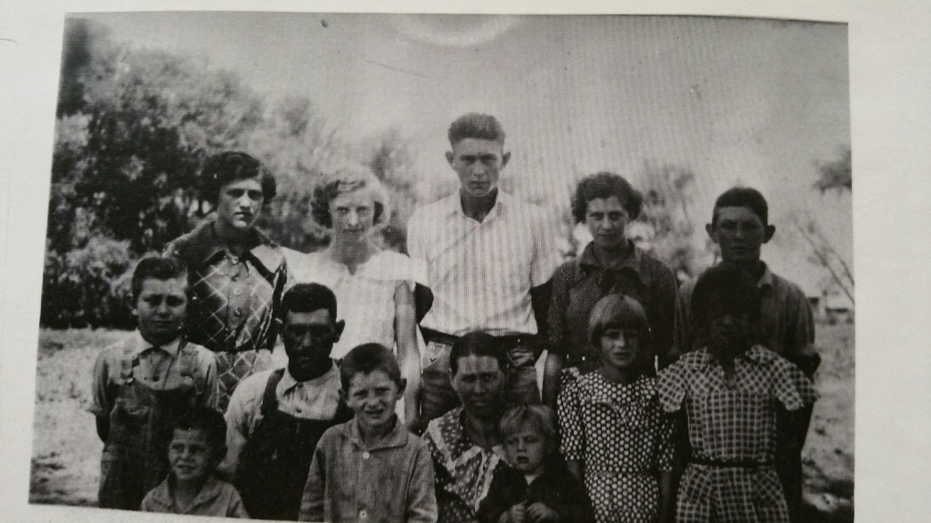
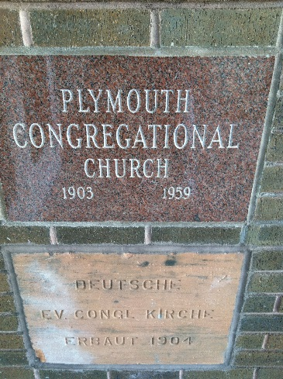
135 Years of Cultural Tradition
Notes:
Best things from that culture continue to drive Ft Collins today
– work ethic, innovation, entrepreneurship,
value of family and community,
music , traditions and beer

